Slide 1

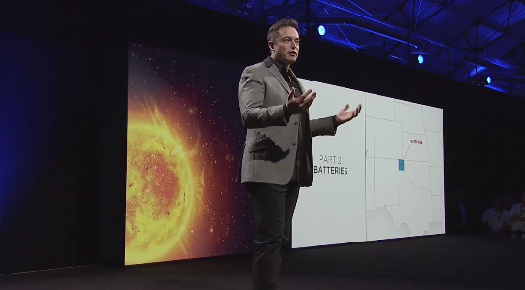
Perfect Pitch Competition
Pitch an innovated (business and technical) solution to a problem connected with the ERC strategic vision in a clear, compelling manner in 90 seconds with one slide
Notes:
Remember:
Less is more – you want the audience to focus on you, not the slide
Only conceptual graphs, diagrams – no material taken straight from your poster
You can arrange and size the boxes any way you like – just make sure those three aspects are clear.

Slide 2
Answer the following three questions in 90 seconds
What real-life problem your research addresses
How you solved it in a unique way
What impact it it your research have for society and in achieving QESST’s mission

Slide 3
Perfect Pitch Competition
What is the real-life problem?
(problem/opportunity)
How does your approach solve it in a unique way?
(solution/proposal)
What will be the impact of your research if you are successful?
(impact/money)
Notes:
Remember:
Less is more – you want the audience to focus on you, not the slide
Only conceptual graphs, diagrams – no material taken straight from your poster
You can arrange and size the boxes any way you like – just make sure those three aspects are clear.

Slide 4
2016 Judging Criteria
Judge #___

Slide 5
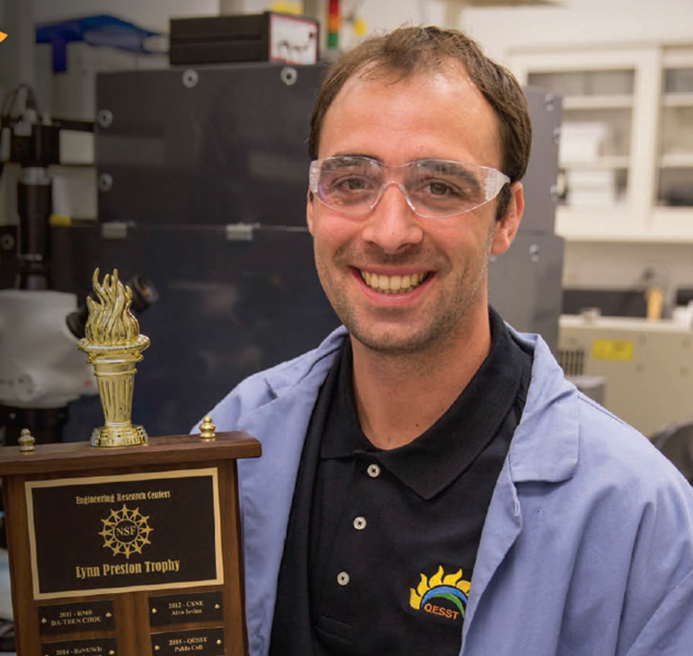
Prize Levels and Dates
2016 – All QESST Competition (only)
There is no ERC-ERC national competition in 2016
National competition to be continued in 2018
Prizes - Top three competitors each win $300
November 21– Practice session immediately following the QESST All-Call meeting
January 16, 11:00 Arizona Time – Practice session via vidyo
January 23, 11:00 Arizona Time – Competition judged by QESST Industry Advisory Board and inventors
Competitors encouraged to compete in eSeed Challenge ($1000) – Teams must have one ASU student

Slide 6

Perfect Pitch Competition
Let Brad West and John Mitchell know your interest
Bradley.west.1@asu.edu
john.j.mitchell@asu.edu
John and Michelle Jordan will connect you with mentors and provide feedback

